Slide 1


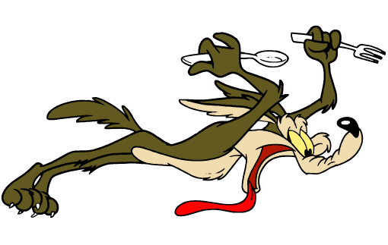


 | Renton Fish and Game Bay 6 Winter Wonderland Warrior Stage: Snow Camp ll Course Designer: Corgi Nation Pistol Team
SCENARIO: (Based on an actual incident with corgis) You are settling in to your tent for the evening in the quiet of a snowy forest. As you get the corgis in for the evening – you hear the unmistakable howl and sniffing around the camp: COYOTES! Save your corgis and dispatch the Wylie Es once and for all!
START POSITION: Kneeling inside the tent, reloading devices on the mat and an unloaded, slide forward gun opposite facing down range. Seated on the ground is permissible if unable to kneel. |  | STRINGS: 1 SCORING: Unlimited SCORED HITS: Best 2 ROUND COUNT: 12 TARGETS: 5 IDPA, 2 NT, 2 PP (small) START-STOP: Audible - Last shot CONCEALMENT: Optional Muzzle Safe Points: Muzzle safe markers / 180 degree rule SO NOTES: PP1 and 2 are 10 yds away, NT targets are sideways (Corgi NT). Steel must fall
STAGE PROCEDURE: At signal, load gun and engage PP1 and PP 2 with at least one round; T1 –5 with 2 rds each.. Stage is to be completed kneeling/sitting. Targets are in the open. NOTES: Mats are on either side place where shooter is kneeling. Tent or can use canopy located at this bay for coverage.
Muzzle safe cone
start

